Slide 1
Development and Evaluation of Power Supply Options for Kosovo: A Background Paper
Conference on “Sustainable Energy for Kosovo”
Pristina
May 14, 2013

Slide 2
The Options Study—Approach
Approach
Demand forecast
Supply options
Alternative power supply plans
Comparison of costs (incl. environmental and health costs)
Sensitivity analysis

Slide 3
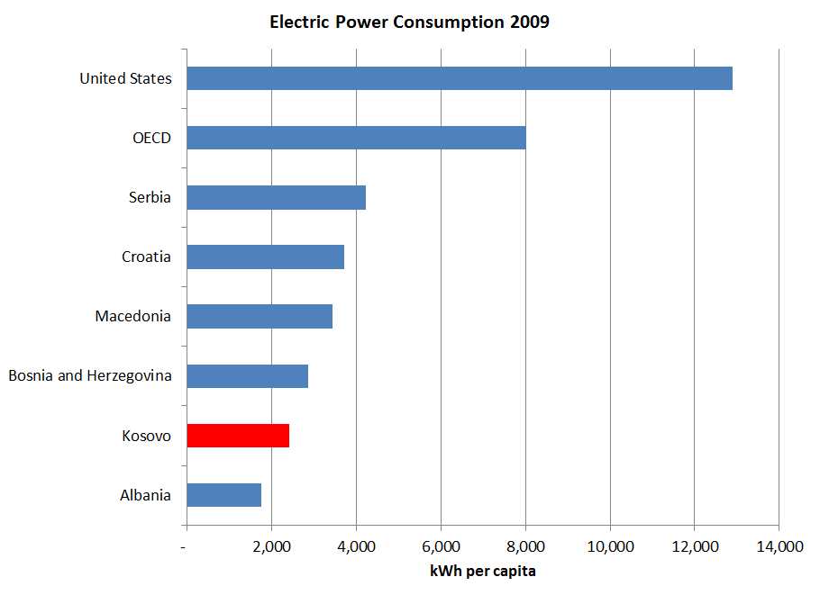
Kosovo’s Electricity Consumption is Low by Regional and International Standards

Slide 4
Power Demand Forecast—Approach
Power demand should reflect the average economic cost of electricity, including the costs of the local environmental impacts of power supply (such as pollution).
We need to forecast required energy to be supplied, which is derived from forecast of energy consumption + energy losses in the power system
Estimated power supply needed to meet forecast power demand to 2025 in following steps:
Two forecast cases derived:
Base case forecast; and
Low case forecast

Slide 5
Power Demand Forecast—Methodology
A simple model that relates future power consumption to:
Future retail price of power; and
Future level of overall consumer income, indexed to GDP
Price and Income are linked to demand:
Price elasticity of minus 0.20 (minus 0.4 for non-technical loss reduction)
Income elasticity of plus 1.31.
This means – for example – that a 10 percent increase in the price of power would reduce consumers’ demand for power by 2 percent; and that a 10 percent increase in GDP would increase consumers’ demand for power by 3.1 percent.
This simplified approach used due to lack of good quality data necessary for a conventional approach.

Slide 6
Power Demand Forecast—Assumptions
An average annual price increase of 4.2 percent is assumed to reach full economic cost by 2025.
For the base case demand forecast, income is projected to increase at 4.5 percent annually, based on IMF’s average projected growth rate for Kosovo’s GDP over the period 2012 to 2016.
For the low case, the projected growth of GDP reduced to a 3.0 percent average annual rate.

Slide 7
Estimated Supply to Meet Forecast Power Demand
Technical losses projected to fall steadily from 16.6 percent in 2010, 13 percent in 2015, 10 percent in 2020, and 8 percent in 2025.
Non-technical losses projected to fall from 20 percent in 2013 to 5 percent in 2018, and to stay at 5 percent up to 2025.
This approach and assumptions results in the following forecast annual average growth rates for the required energy supply between 2011 and 2025
Base case: 4.6%
Low case: 2.9%
These assumptions reflect the adoption of sound policies and actions by the government.

Slide 8
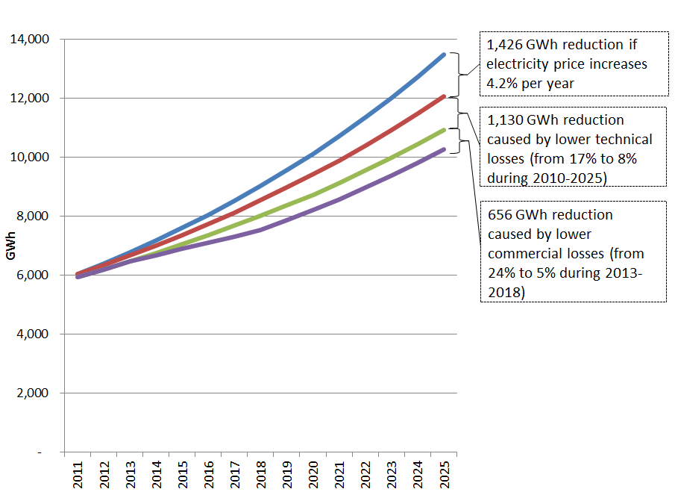
Demand Forecast—Required Energy Supply

Slide 9
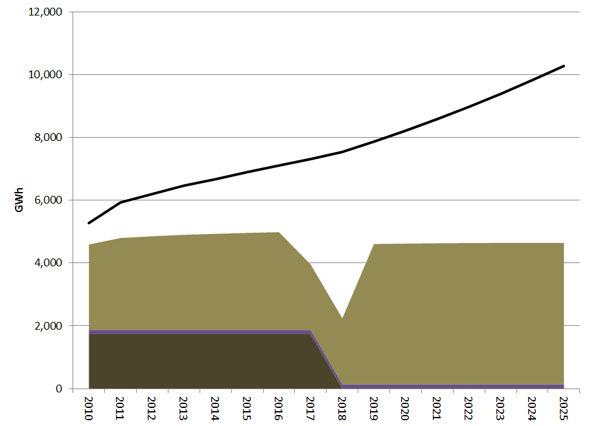
Demand-Supply Gap—Energy
5,600 GwH
3,600 GwH
5,300 GwH
Kos B
Existing Small Hydro
Kos A

Slide 10
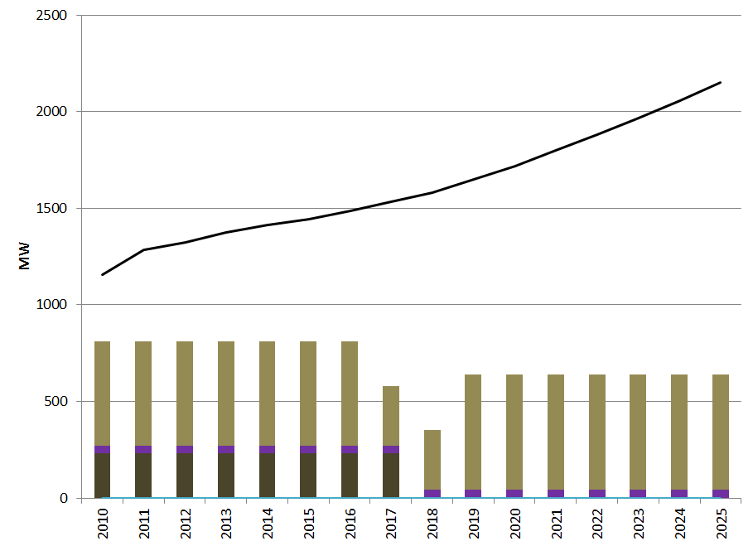
Demand-Supply Gap—Peak Demand
1,500 MW
950 MW
1,100 MW
1,200 MW
Kos B
Existing Small Hydro
Kos A

Slide 11
Supply Options—Renewables
Large hydro: 305 MW Zhur plant could be built by 2017 to serve demand peak demand, but provides only 425 GWh (16% capacity factor).
Small hydro: 18-20 sites with about 60 MW capacity total. Capacity factor of 53%.
Wind: Few areas with speeds that make it commercially viable.
Biomass and biogas: Biomass from forestry products and residue a possible source of distributed (not grid connected) generation; manure-based biogas from livestock a possible source of distributed lighting and heating
Solar PV: Studies have identified potential of roughly 80 MW, but at very high cost.
Geothermal: 2008 EC report found that soil and water temperatures too low for electricity generation.

Slide 12
Supply Options—Fossil Fuels
Lignite: Sibovc mine has enough lignite to supply Kosovo A, B, and KRPP to the end of their operational lives.
Natural Gas: Kosovo does not have gas resources or a gas transmission system. Timing of gas import is highly uncertain.
Fuel Oil: All liquid fuels would have to be imported.

Slide 13
Supply Options —Key Concepts for Cost Comparison
Levelized energy cost (LEC): The sum of costs, per unit of electricity generated by a plant, over the plant’s lifetime.
Such costs include:
Construction costs
Operating and maintenance costs
Cost of capital
All costs are discounted to present day dollars.
Note: We use economic and not financial cost. Economic analysis is concerned with costs to economy or society as a whole, not only costs to investor.
Externalities: Costs created by the power plant that are not incurred by the plant owner/operator but instead are incurred by other "third" parties.
Study accounts for the costs of “negative” externalities: The global and local environmental and health consequences of the thermal plant options.
Carbon prices have recently registered a decline and are about €3/tonne in ETS, but this study assumes medium-term price rises: €15/tonne in 2010, €23/tonne by 2025, and €26/tonne by 2030.
This study assumes local negative externalities equal to €3.50/MWh

Slide 14
Supply Options—Levelized Energy Cost Comparisons
Lignite plant is lowest cost fossil fuel option at higher levels of utilization
Table below compares costs of all plants at low (20%), moderate (60%), and high (90%) levels of utilization
 | Low (20%) | Moderate (60%) | High (90%)
 | €/kWh
Lignite | 0.18 | 0.09 | 0.08
Zhur Hydro | 0.08 | Only capable of 16% utilization
Small Hydro | 0.12 | Only capable of 53% utilization
Wind | 0.11 | Only capable of 20% utilization
CCGT (natural gas) | 0.14 | 0.10 | 0.09
Fuel Oil | 0.20 | 0.17 | 0.16

Slide 15
Alternative Power Supply Plans—Approach
LECs are useful for comparing one plant to another, but not for selecting the least cost power supply plan. A different approach is needed.
Evaluates alternative power supply plans. A supply plan is a multi-year sequence of new generating plants designed to meet forecast demand.
Criteria for the alternative plans:
Balance annual consumption and generation to 2025
Allow system to meet peak demand without excessive reliance on imports
RE capacity should be cost-competitive with thermal options, including externalities
RE plants have priority dispatch (their energy is used first, before thermal)

Slide 16
Alternative Power Supply Plans
Each alternative has an RE package and a fossil fuel option
Alternative fossil fuel plants
600 MW lignite plant (2x300 MW)
575 CCGT natural gas plant
575 CCGT light fuel oil plant
RE package same for each alternative supply plan:
305 MW Zhur plant
60 MW small hydro
250 MW wind
20 MW biomass
70 MW biogas

Slide 17
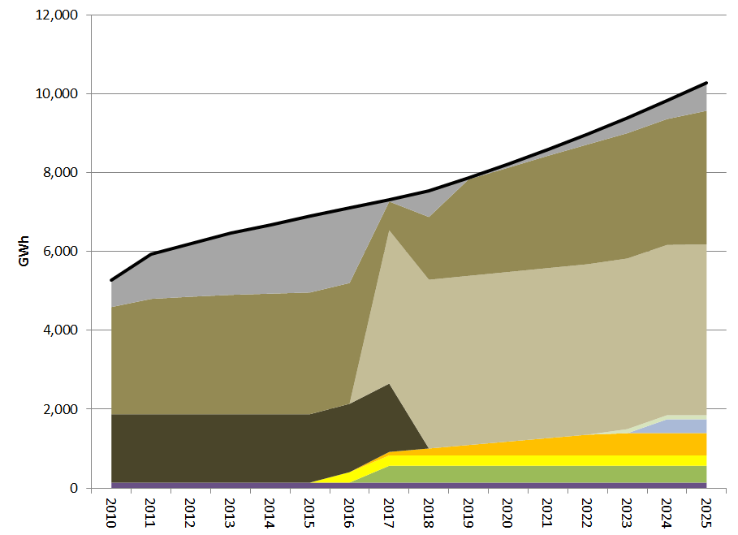
Lignite + RE Plan for Filling Demand-Supply Gap
Imports
KRPP
Kos B
Generation from RE=14% in 2020, 18% in 2025.
Kos A

Slide 18
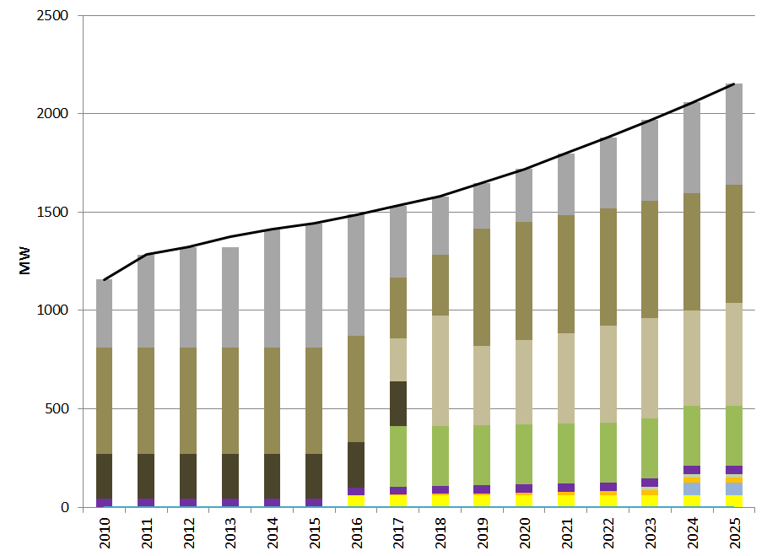
Lignite + RE Plan for Filling Demand Supply Gap—Peak Demand
Imports
KRPP
Kos B
395 MW of new RE capacity installed but only ~170 MW can be used to reliably meet peak
Zhur
Kos A

Slide 19
Alternative Power Supply Plans— Conclusion
Lignite is the power supply of choice even under scenarios substantially different from the most likely scenario
Lignite is competitive with gas even if:
Demand grows at only 2.9% per year (instead of 4.6% as in the base case forecast)
The forecast cost of CO₂ is higher by 55%
The construction cost of the lignite plant is higher by 25%
Lignite prices increase by 70%
Gas prices decrease by 15%.

